Slide 1
Generative AI For Data Analysis
Overview
This lesson focuses on applying generative AI for data analysis. Instructors will guide students through the benefits and practical applications of using cutting edge AI tools to interpret and analyze data.
Learning Objectives
Identify the different capabilities of ChatGPT for Data Analysis
Use ChatGPT to perform exploratory data analysis

Slide 2
Suggested Agenda (1 hour)
0:00-0:02 Review Learning Objectives
0:02-0:25 How to Use ChatGPT for Data Analysis
0:25-0:40 Practice: ChatGPT for Data Analysis
0:40-0:50 EDA with Generative AI
0:50-0:58 A Cautionary Tail - ChatGPT for Data Analysis
0:58-0:60 Reflection
*these are estimates - timings will vary!

Slide 3
Teaching Guide:
Use the following quick tips for instructional guidance.
Title | What to Do
Learning Objective Slides | Pause to unpack the learning objectives and prime students for the lesson. This is a crucial step in the learning process and gives participants time to build context and activate any prior knowledge.
Solo Activities | For solo activities, you can choose to put people in group breakout rooms (to create the “table” group that they would be in in a physical setting) or allow students to work independently in the main session.
Group and Partner Discussions and Exercises (Remote) | Creating Breakout Rooms — Group and Partner Exercises Set up breakout rooms for pairs/groups. Broadcast directions and discussion questions to all breakout rooms. At the 60-seconds-left mark, broadcast a message to all rooms: “Start to wrap up your discussions. Rooms will close in one minute!” Move around from breakout room to breakout room to “walk around the classroom.”
Group and Partner Discussions and Exercises (In Person) | Facilitating Group and Partner Discussions and Exercises — Live Classroom Arrange the room prior to the session to create a conducive environment for group work. Provide clear, concise instructions verbally and on a handout or slide for the exercise, ensuring that all participants are aware of the goals and the time allocated. Circulate around the room to engage with groups Display a timer or announce when there is 1 min remaining Facilitate the sharing of group conclusions or discussion points with the whole class, ensuring that each group has a voice.

Slide 4
For Data Analysis
Notes:
We’re now going to look at one of the most fascinating areas where Generative AI can help us, and very specifically we’re going to look at ChatGPT.

Slide 5
Identify the different capabilities of ChatGPT for Data Analysis
Use ChatGPT to perform exploratory data analysis
Notes:
We’re going to focus on a Beta version of ChatGPT that knows how to write and execute python code, and can work with file uploads. You can try asking for help with data analysis, image conversions, or editing a code file.

Slide 6
How to Use ChatGPT for
Data Analysis
Notes:
Let’s get on with it and talk about this version, which was at first called Code Interpreter.

Slide 7

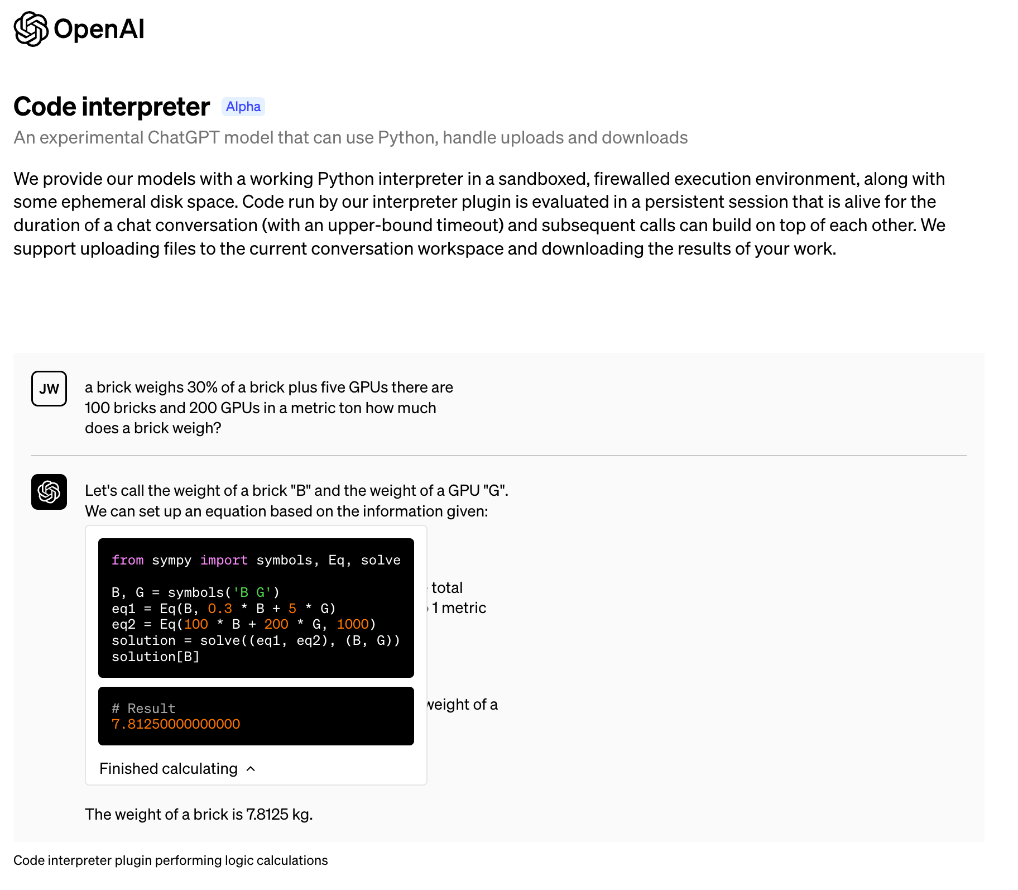
Code Interpreter, now Advanced Data Analysis
In March 2023, OpenAI announced “Code Interpreter”, an experimental ChatGPT model able to run Python code and work on uploaded files.
It was renamed Advanced Data Analysis (ADA), and now it lives within the GPT-4 Default chat!
Current supported file types include:
PDF (.pdf)
Text (.txt)
PowerPoint (.ppt)
Word (.doc)
Excel (.xlx)
Comma-separated values (.csv)
Notes:
NOTE: It works in a sandboxed, firewalled environment, which means that it cannot leak your files, and that they will not persist beyond a single session. This session can also time out quite easily, so make sure you’re all ready and prepped to go!
PURPOSE:
Introduce the evolution of the "Code Interpreter" feature by OpenAI and its transition to "Advanced Data Analysis (ADA)".
TALKING POINTS:
• Highlight of OpenAI's announcement in March 2023 about the experimental "Code Interpreter".
• Discuss the capability of the ChatGPT model to run Python code and handle file uploads.
• Mention the renaming of "Code Interpreter" to "Advanced Data Analysis (ADA)".
• Explain the types of files currently supported by ADA.
TEACHING TIPS:
• Use real-world examples to showcase the practical applications of ADA, especially for data handling and analysis.
• Engage the audience by asking them about their familiarity with such tools and if they've encountered similar features elsewhere.
• Point out the example of ADA's use-case shown in the slide for more context.

Slide 8
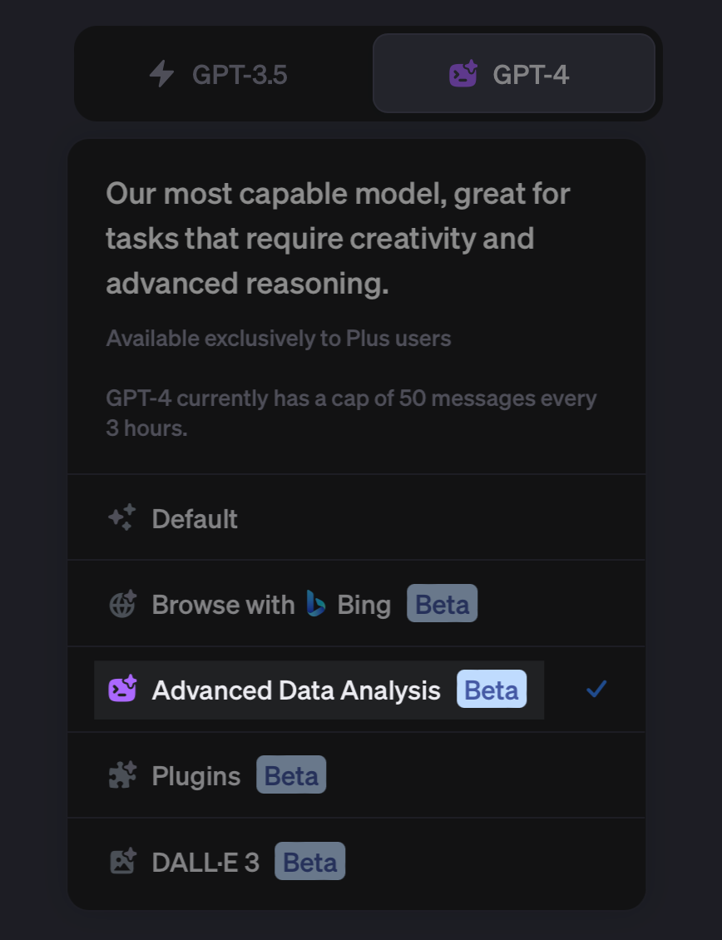
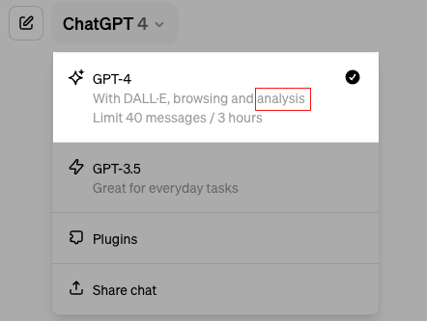
From This…. To This!
Notes:
PURPOSE:
To show that ADA used to be separate from the default chat, now it lives within it.

Slide 9

ChatGPT Advanced Data Analysis, Your Coding Intern
Comprehensive: familiar with all public coding documentation until Sep 2021.
Speedy Outputs: produce entire programs in seconds.
Adaptive: can read error messages and self-correct.
Over-compliant: executes tasks as directed, even if ill-advised…
Receptive to feedback: adjusts swiftly to your input.
Requires good prompting: practice makes perfect.
Notes:
Many of us have probably hit a bottleneck where we need someone to write some code or perform some analysis, but these people are often in high demand. ChatGPT Advanced Data Analysis might just be the closest thing to that dream.
PURPOSE:
To familiarise participants with ADA's capabilities and idiosyncrasies, enabling them to effectively collaborate with this unique digital intern.
TALKING POINTS:
• Global Archive: Think of ADA as having memorised the world's public coding manuals up until September 2021. It's like having a repository of coding knowledge right at your fingertips.
• Speed and Efficiency: Imagine writing programs at breakneck speed. With ADA, extensive coding tasks are completed in mere seconds.
• Self-Correction: One of ADA's standout features is its adaptability. It can understand error messages and attempt real-time corrections.
• A Double-Edged Sword: ADA’s diligence means it won't challenge you, even if you're heading down a questionable path. As with any intern, guidance is key.
• Open to Learning: Feedback is gold. ADA assimilates it and fine-tunes its responses.
• The Art of the Prompt: Engaging with ADA isn't just about commands; it's about crafting the right prompts. Perfecting this takes trial, error, and a depth of understanding. We’ll help speed up this process!
TEACHING TIPS:
• Draw parallels between ADA and traditional coding interns, emphasising ADA's unique advantages and the necessary oversight.
• Share anecdotes or personal experiences to illustrate ADA’s capabilities and the quirks of working with it.
• Remind participants of the importance of reviewing every output and setting the right parameters for task execution.

Slide 10
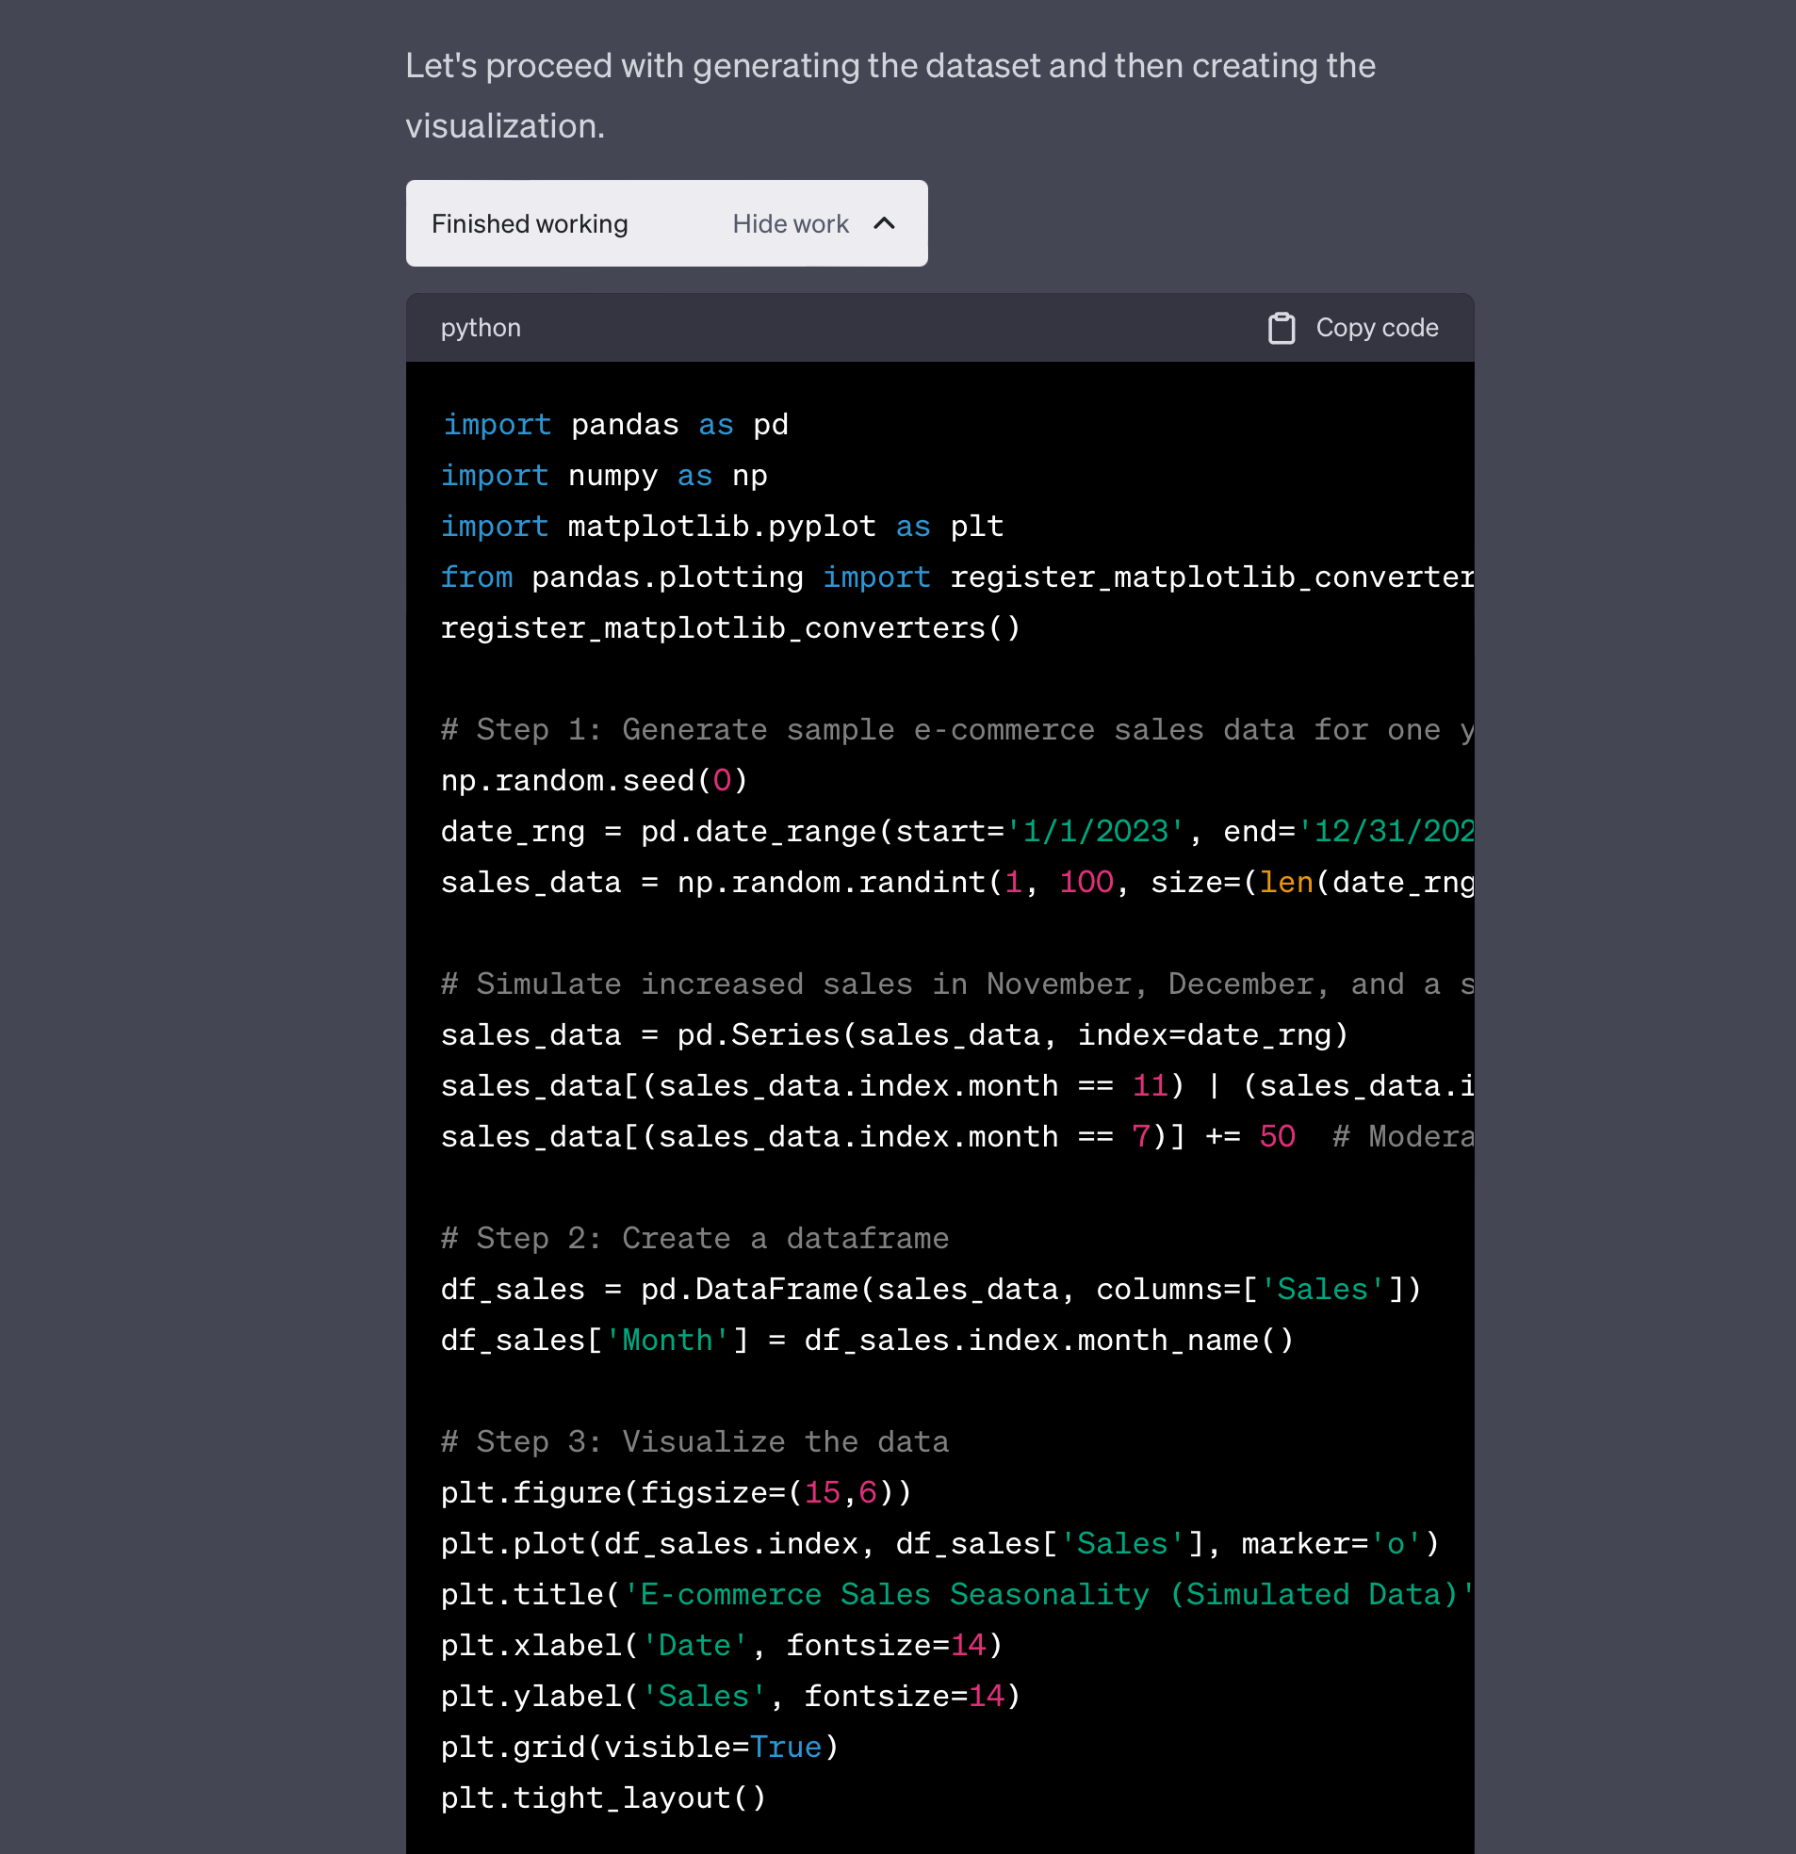
Introducing ADA
10 min
Introducing how it works
First, let’s visualize without any data
Next, let’s take a look at a CSV
Let’s write a program that renames invoices. Or at least try…
Now, let’s do a find and replace on a PowerPoint
Notes:
Practice Activity:
Guided Walkthrough: Advanced Data Analysis
First prompt: “Please create an example visualization that demonstrates the seasonality of e-commerce sales.”
Click “Show Work” while it’s generating and explain that this is Python code, and that the comments show what it’s doing.
Once it has generated an image, explain that it has generated this (downloadable) image using a library, and while it doesn’t have access to every single library, there’s a lot that it can do.
Second prompt: “If I wanted to run this code myself, how could I do that? I have a MacBook Pro.”
Upload Life_Expectancy_Data.csv and ask “Here is some data on life expectancy. look through it and tell me what you find.”
ADA will probably suggest some further explorations, ask e.g. “Can we visualize trends in life expectancy over the years globally and within specific countries or regions?”
Hopefully at this point it will start to make some mistakes - point out that this is a feature not a bug - we all make mistakes, but thankfully ADA has the ability to correct itself.
Let’s write a program that renames invoices.
Upload Invoices-to-rename.zip and ask: “Please write me a program to rename these invoices to include the name of the company that issued them. So for example, invoice-01.docx would become company-name-invoice-01.docx Take a deep breath and work on this problem step-by-step.”
While the prompt is progressing, mention some of the notes from the previous slides - there will be some problems with one of the files!
Now ask: “What about if you converted the files to plain text first, and then tried to pattern match for likely company names?”
Don’t be afraid to move on, even if you haven’t completed the task!
Open up the Better Business Act Communications.pptx and show a few of the pages
Now upload it and ask: Can you do a find and replace on this presentation and replace every instance of the word "Better Business" with "Cool Company"?
Download the output and show the result

Slide 11
ChatGPT ADA + Python
ChatGPT Analysis is essentially an LLM that can run Python code. So…
What exactly is Python?
Notes:
PURPOSE:
To prime students for the next 3 slides. Don’t spend much time here!

Slide 12

What is Python?
Python is a high-level, interpreted programming language.
It's used for web development, data analysis, AI, and more.
It emphasizes readability and simplicity in its syntax
It a popular choice for beginners and experienced developers alike.
Source: python.org
Notes:
PURPOSE:
To introduce Python as a high-level programming language and highlight its key features and use-cases.
TALKING POINTS:
• Python is a versatile high-level programming language.
• It is commonly employed in various domains such as web development, data analysis, and artificial intelligence.
• The language's simplicity and emphasis on readability make it a top choice for both novice and seasoned developers.
TEACHING TIPS:
• Begin by asking learners if they have any prior knowledge of Python or any other programming languages.
• Use real-world examples to highlight Python's versatility in different applications.
• Encourage learners to share their experiences or knowledge about the language.

Slide 13

What are Python Libraries?
Python libraries are pre-written code modules
They help developers avoid "reinventing the wheel."
Examples include:
NumPy for numerical operations
Flask for web applications
Pandas for data visualization
Notes:
PURPOSE:
To explain the concept of Python libraries, their benefits, and provide some popular examples.
TALKING POINTS:
• Python libraries are sets of pre-written code that developers can leverage to ease their coding tasks.
• These libraries save time by preventing developers from "reinventing the wheel".
• Some renowned libraries include NumPy for mathematical tasks, Flask for web applications, and Pandas for data visualization and manipulation.
TEACHING TIPS:
• Start by inquiring if anyone has previously used any libraries or modules in other programming contexts.
• Give practical examples, like using Pandas for analyzing a dataset or Flask for setting up a simple web application.
• Pose a question: "Why might it be beneficial to use pre-written code modules?"

Slide 14
A Few Use Cases For Python and Python Libraries
Text Analysis
Classification, sentiment analysis
Machine Learning
Build predictive models, segment
Image Processing
Resize, convert, QR codes, GIFs
Data Visualization
Create charts, maps, diagrams
Computer Vision
Face detection, OCR
Data Analysis
Build dashboards, generate insights

Slide 15
ADA doesn’t know everything it can do.
Notes:
Advanced Data Analysis doesn’t know all of the libraries it has access to, and it doesn’t know everything it’s capable of.

Slide 16
Libraries ADA Might Be Unaware Of
Text Analysis
TextBlob, Spacy
Machine Learning
PyTorch, TensorFlow, scikit-learn
Image Processing
OpenCV, Pillow
Data Visualization
seaborn, folium
Computer Vision
pytesseract
Data Analysis
Plotly
Note: You don’t have to know exactly how libraries work or be an expert coder to tell ChatGPT to use a particular library!
Notes:
NOTE: Have students save this slide for future reference. Let them know that they don’t have to know exactly how the libraries work, or be expert coders, to ask ADA to use a particular library. PURPOSE:
To shed light on ADA's capability to access a plethora of Python libraries and highlight the importance of user prompting.
TALKING POINTS
• ChatGPT ADA comes equipped with access to over 300+ Python libraries in a sandboxed environment.
• However, ADA itself isn't inherently aware of this vast arsenal at its disposal.
• It's up to the user to prompt and navigate ADA to utilize these libraries effectively.
• This means users need a foundational understanding of the available libraries and how they can be leveraged in their queries.

Slide 17
ChatGPT for Data Analysis

Slide 18
ChatGPT for Data Analysis
Potential Use Cases:
15 Minutes
Try out Advanced Data Analysis. Feel free to try working with any of the files in your Participant Folder, including images.
Instructions:
Try asking for help with one of the following:
Data analysis with spreadsheets
Image conversions (including cropping)
Editing a Python file
Doing a find and replace on a document
Building a predictive model!
1
First upload the file(s) and ask for some initial help.
2
Remember: ChatGPT is over-compliant BUT receptive to feedback. Refine the prompt/with follow-ups.
3
Share what you’ve learned - both what you can and can’t do - in the meeting chat.
Notes:
SOLO ACTIVITY
Go through the instructions - provide a quick demo if students are confused.
Students complete activity. Monitor their progress and answer questions throughout.
Debrief after the activity:
How did the process of uploading files and requesting assistance enhance your understanding of data analysis, and what challenges did you encounter while working with the tool?
Can you describe a specific instance during the activity where you had to refine your approach based on the output from ChatGPT? How did this impact your final outcome?

Slide 19
Exploratory Data Analysis
With Generative AI

Slide 20

What is Exploratory Data Analysis (EDA)?
Exploratory Data Analysis (EDA) is the initial process of analyzing and visualizing data sets to summarize their main characteristics, identify patterns, and inform subsequent analysis.
EDA is essentially just “getting to know” a data set.

Slide 21
Guided Walkthrough:
EDA with Gen AI

Slide 22
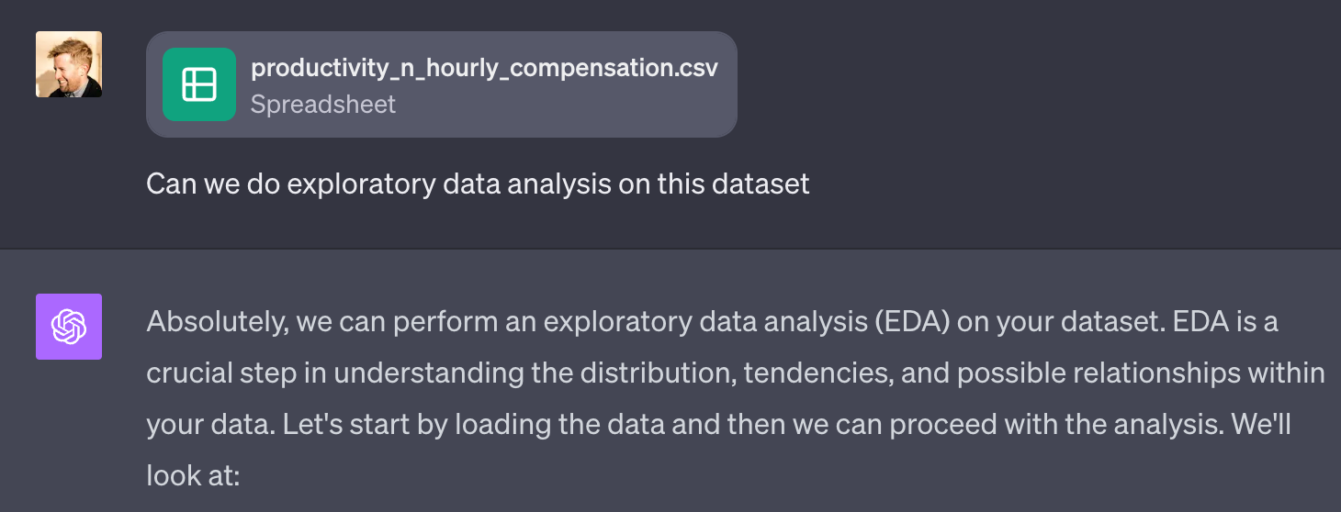
EDA with Gen AI
10 min
Productivity & Hourly Compensation Data
Ask: “can we do exploratory data analysis on this dataset”
Prompt for further exploration.
Request the top five insights
Ask for suggestions on what actions policymakers could take based on these insights.
Notes:
Practice Activity:
Guided Walkthrough: Advanced Data Analytics ChatGPT Plugin
Download this sample Data Set (which comes from Kaggle)
This data set compares productivity and hourly compensation from 1943-2021
Load the csv and ask some preliminary data analysis questions
REMIND PARTICIPANTS TO NEVER LOAD CSVs WITH SENSITIVE CONSUMER DATA
Give participants ~5 minutes to play around themselves before moving to the reflection and next microlesson.
Make sure to:
Show participants how to download a chart.

Slide 23
A Cautionary Tale:
ChatGPT for Data Analysis

Slide 24
Hallucinations + Data Analysis
It is extremely important to remember that ChatGPT, as well as any other LLM, can have hallucinations at any point.
This has some serious implications when using ChatGPT to work with data.
Notes:
PURPOSE:
To emphasize the importance of being cautious of possible hallucinations when using ChatGPT, especially in data analysis.
TALKING POINTS
• ChatGPT, like other language models, can produce outputs that aren't based on factual data, known as "hallucinations".
• Recognizing these hallucinations is vital, especially when making data-driven decisions.
• The potential consequences of using such hallucinated data can be severe in real-world applications.
TEACHING TIPS
• Highlight real-world examples or hypothetical situations where relying on incorrect data can have negative outcomes.
• Discuss the difference between a model's prediction and hallucination.

Slide 25
Hallucinations + Data Analysis
1.
ChatGPT may generate fake data that it needs to complete a user request.
2.
ChatGPT will often hint that it is creating fake data, but it is easy to miss.
3.
For this reason, it is critical that you document the use of ChatGPT when working with data, especially if you are not a data professional yourself!
Notes:
PURPOSE:
To provide a detailed overview of how ChatGPT interacts with data and the implications of its hallucinations.
TALKING POINTS
• ChatGPT can generate data to fulfill user queries, but it's not always real or accurate.
• The model may give subtle indications that it's producing fictitious data, which can be easily overlooked.
• It's crucial to validate and cross-check any data from ChatGPT, especially if one isn't familiar with data analysis.
TEACHING TIPS
• Use examples to demonstrate how a subtle hint from ChatGPT might look when it's generating data.
• Stress the importance of consulting with data professionals when using AI-generated data for critical applications.

Slide 26

Think About It: Data Analysis 🤔
What are some of the worst things that could happen when using ChatGPT for Data Analysis?
Type your response in the chat.

Slide 27
On ChatGPT ADA

Slide 28
Reflection: On ChatGPT ADA
1
To what extent do you agree that the ability to run code represents “GPT 4.5”?
2
Which capabilities are you keen to try out for yourself, with your own data?
3
How do you plan to apply what you’ve learned in your work?
Notes:
- Ask participants to reflect on their own, either in their own heads or by jotting down notes
- If they would like to share their reflections, let them know they can do so in the Zoom chat

